Slide 1
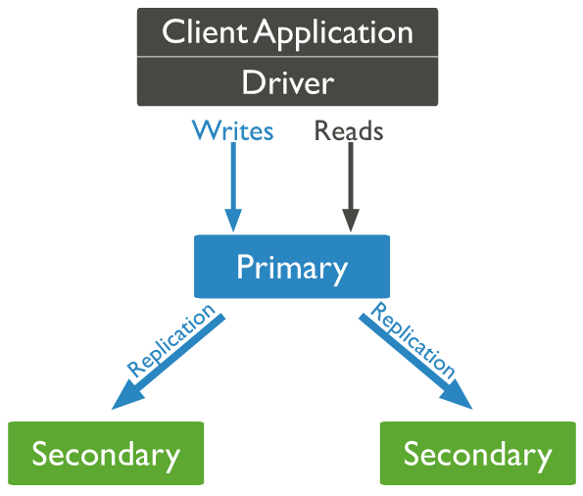

From a Replica set to a Standalone - MongoDB
3 Nodes ReplicaSet
For testing and development purposes using a standalone mongod instance should be enough, but we always use a replica set in production, since we have to cater to high availability and fault tolerance of a database.
When the development teams realized it is costly to be running 3 aws instances, for a replica set in development environment, they decided to convert it into a standalone and terminate the rest of the nodes.
Briefly, a replica set is a group of mongod instances each storing a copy of the data by means of replication.This allows for automatic failover, to overcome the loss of one single database server.
Our replica set is made up of 3 running mongod EC2 instances with one primary instance and two secondary instances.
Primary
Secondary1
Secondary2
Localhost:27017
Localhost:27018
Localhost:27019

Slide 2
From a Replica set to a Standalone - MongoDB
3 Nodes ReplicaSet
The Primary accepts writes from the client application and asynchronously sends a copy to the secondaries.
In MongoDB , only the primary instance can successfully accept and acknowledge writes, the rest of the instances will be added to the replica as secondaries and reflect the sets of data on primary.
An election occurs when the current primary fails, and one of the available secondaries will elect itself as the new Primary. .Each instance of the replica communicates with each other by means of a heartbeat. Unless there is a primary Database server, Database will not accept writes from the application.
Primary
Secondary1
Secondary2
Localhost:27017
Localhost:27018
Localhost:27019

Slide 3
From a Replica set to a Standalone - MongoDB
Let us see the steps of converting this replica set into a standalone. Keep in mind, operating as a standalone database is not recommended for production , due to the single point of failure that a single running database is at a risk of facing.
First remove the secondary hosts from the replica.
The below command has to be run inside the primary instance.
rs.remove(“hostname:27018”)
rs.remove(“hostname:27019”)
The replica set status will only show the primary instance now.
Switch to the local Database and drop the local database.
use local;
db.dropDatabase();
Local database in mongodb is where there the internal replication information of each mongod instance of the replica set is stored.
Next, exit the shell and open the mongodb configuration file.
vi /etc/mongodb.conf
Edit the file to remove the replSet parameter.
Then restart the mongodb service and enter the shell again.

Slide 4
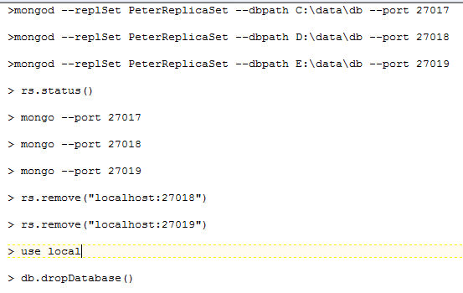
From a Replica set to a Standalone - MongoDB

